Slide 1
Sales Dashboard Project – Summary Presentation (By Avantika Kadam)

Slide 2
Project Objective Title: Sales Dashboard – Executive Insights Objective: To analyze sales performance across products, regions, customer segments, and time periods, using interactive visuals to support strategic business decisions.

Slide 3
Dataset Overview Dataset Includes: 💰 Sales data per transaction 📦 Product Details: Category, Sub-Category 🌍 Customer Info: Region, State, Segment 📆 Time Info: Order Date, Ship Date 📬 Postal Code (some nulls present) Preparation: Converted dates, split time fields (Year, Quarter, Month) Cleaned nulls and missing fields Created calculated fields (e.g., Profit, Growth)

Slide 4
KPI Summary Key Metrics: 🟢 Total Sales 🔼 Monthly/Quarterly Sales Growth 📦 Sales by Category & Sub-Category 👥 Top Customers / Segments 🌍 Regional Performance Displayed using: Cards, Line Charts, Bar Charts, and Heatmaps Design Focus: Clean visuals, consistent colors Responsive layout for easy exploration

Slide 5
Overview Visuals: 💳 Total Sales (Card) 📈 Sales Trend Over Time (Line Chart by Month) 🌎 Sales by Region (Map/Bar Chart) 🎛 Filters: Year, Region, Category Purpose: High-level summary of business performance. Product Insights Visuals: 📊 Sales by Category & Sub-Category (Bar Chart) ⭐ Top 10 Products by Sales (Bar Chart or Table) 💹 Profit (if available) 🎛 Filters: Category, Month Purpose: Deep dive into product-level performance. Customer & Segment Analysis Visuals: 👥 Sales by Segment (Bar Chart) 🧍 Top N Customers by Sales (Sorted Bar Chart) 🌡 Heatmap: Segment vs. Region (Matrix with conditional formatting) Purpose: Understand which segments and customers drive revenue. Interactivity Features, User Controls: 🔄 Slicers: Year, Region, Category, Segment 🔽 Drilldowns: Year → Quarter → Month 🧊 Tooltips: Show product name, exact sales on hover 🔘 Navigation Buttons: Jump between pages with bookmarks

Slide 6
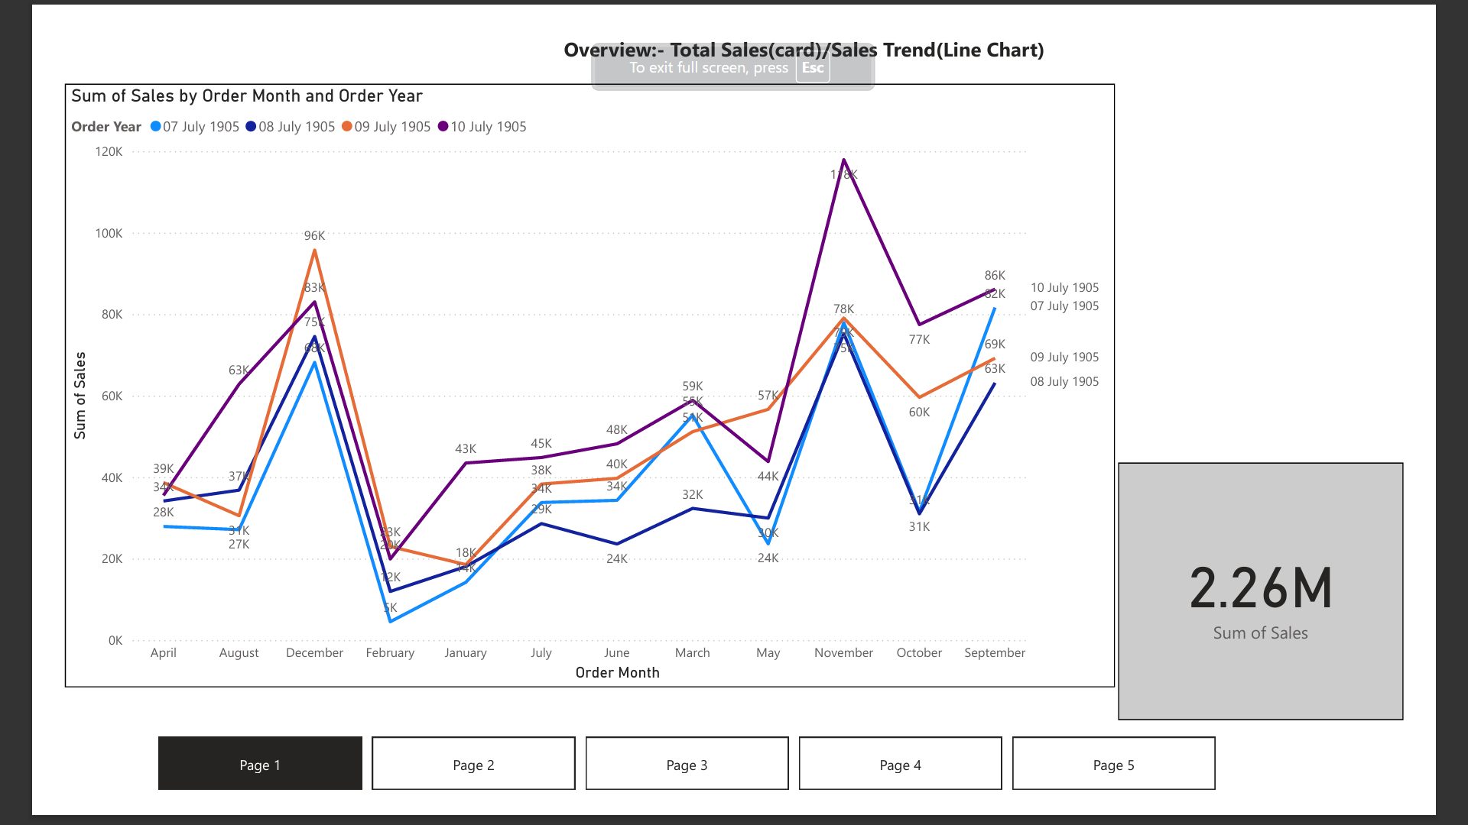

Slide 7
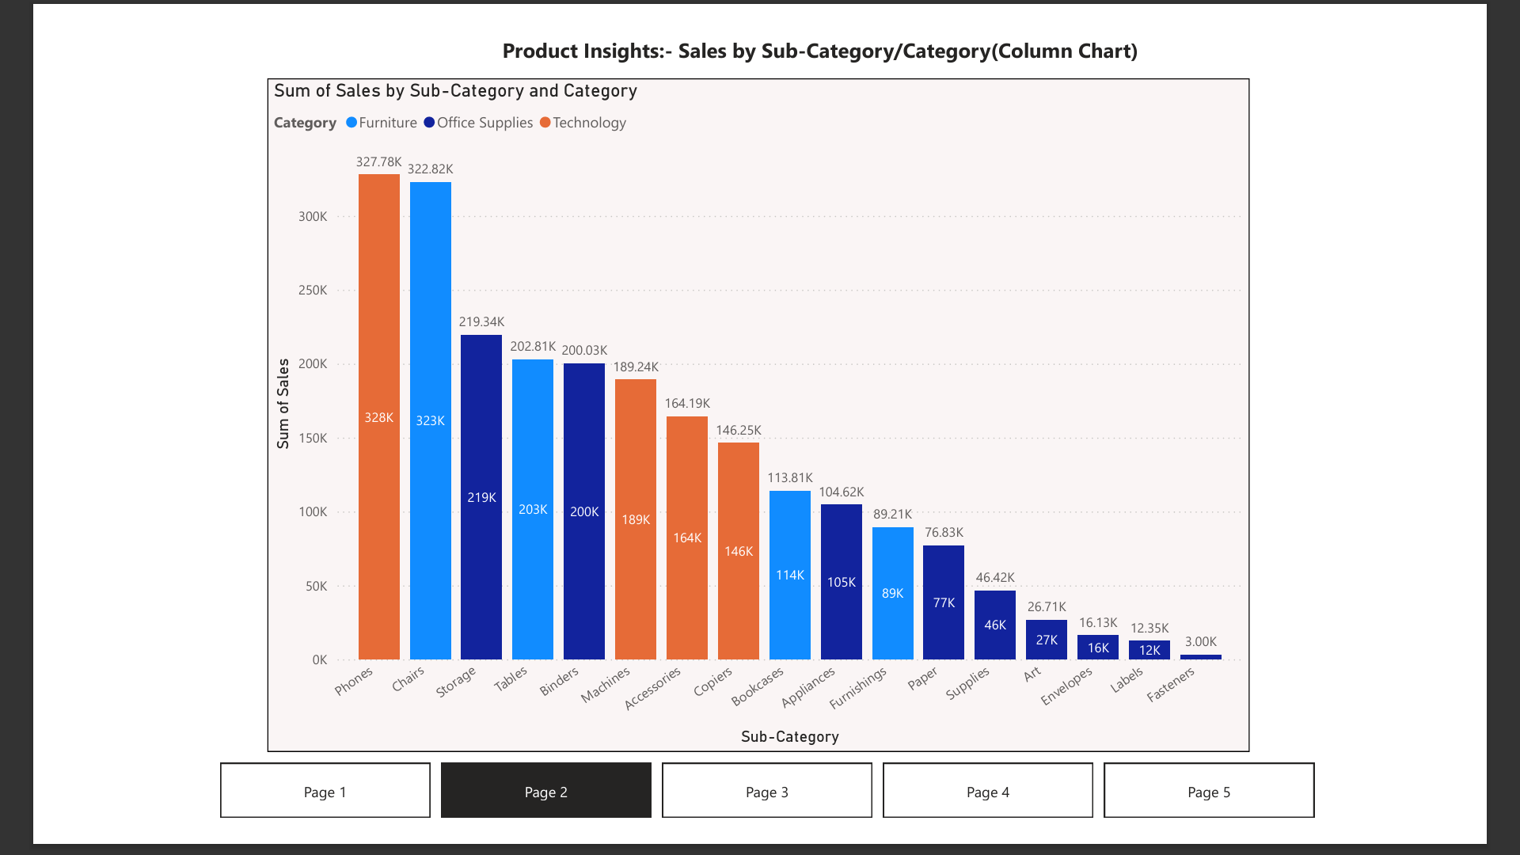

Slide 8
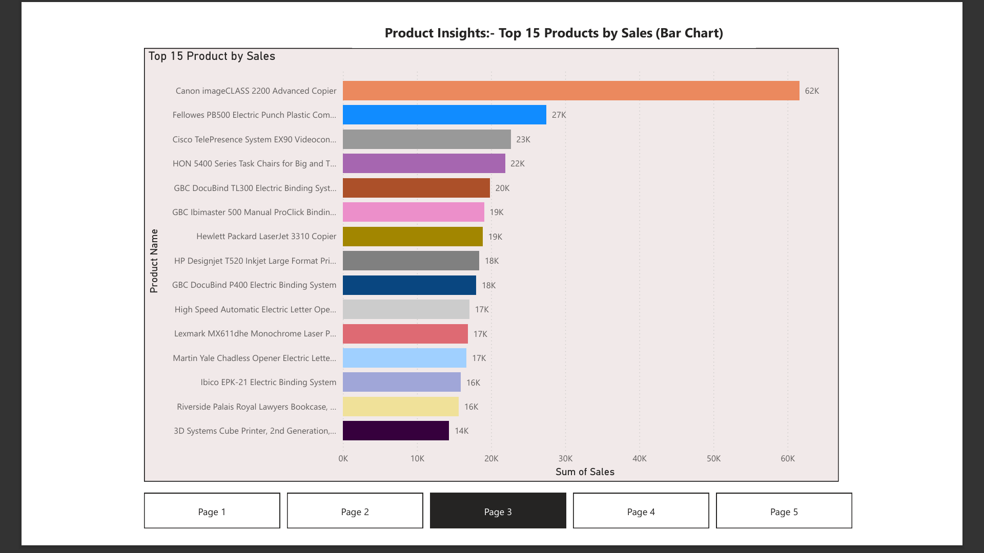

Slide 9
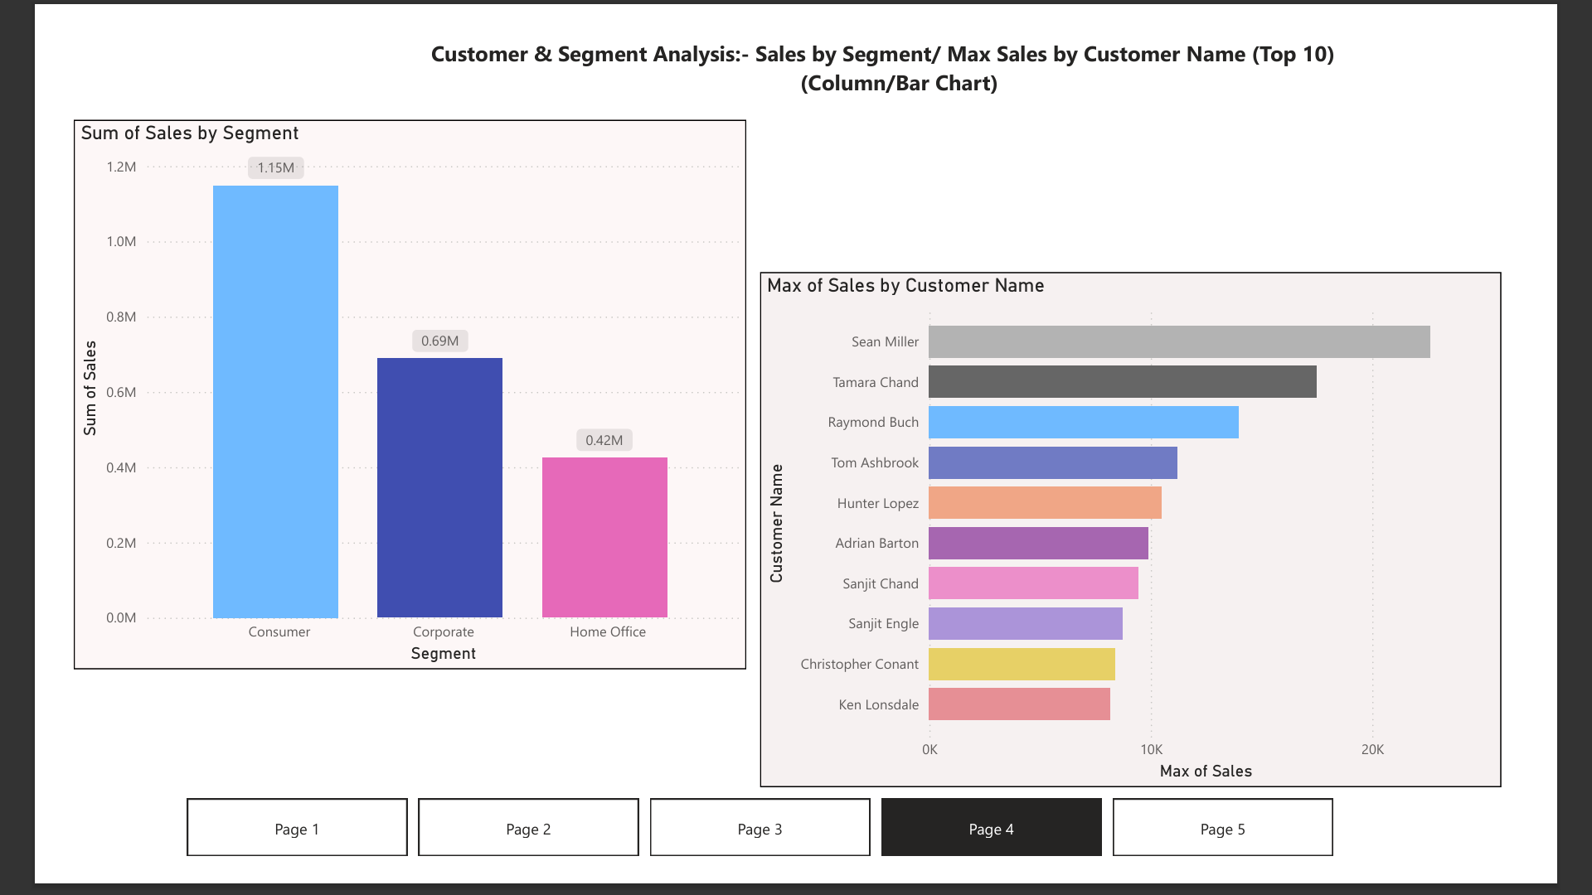

Slide 10
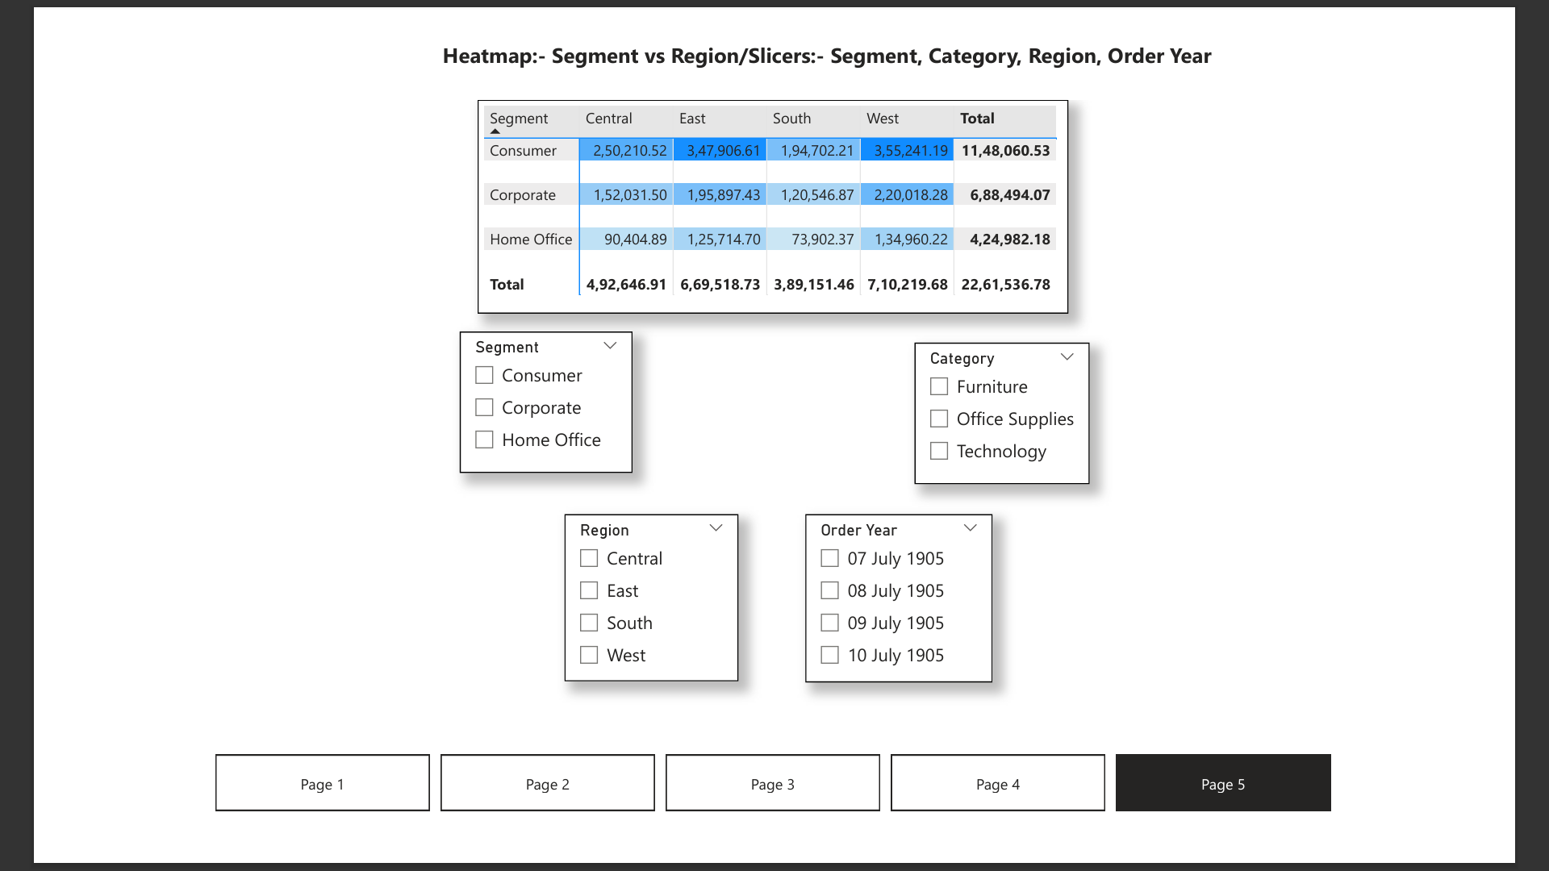

Slide 11
Key Business Insights 🚀 Identify high-performing product lines and regions 📉 Spot seasonal trends and downturns 👤 Target top customers & profitable segments 🧭 Use regional trends to guide expansion or marketing

Slide 12
THANK YOU

